Slide 1
Copernicus
Presented by Andreas Brink
Joint Research Centre – European Commission

Slide 2

What is Copernicus
Copernicus is the European Union programme aimed at developing European information services based on satellite Earth Observation and in situ data
Copernicus is coordinated and managed by the European Commission
Copernicus is implemented in partnership with the Member States, the European Space Agency (ESA), the European Organisation for the Exploitation of Meteorological Satellites (EUMETSAT), the European Centre for Medium-Range Weather Forecasts (ECMWF), EU Agencies and Mercator Océan
Copernicus Multiannual Financial Framework 2021-2027 > 5 billion €
Copernicus data and infrastructure guaranteed beyond 2030
Notes:
The total amount of 14.8 billion euros will be allocated for the programme with 9.1 billion euros for Galileo and EGNOS, 5.42 billion euros for Copernicus and 442 million euros for SSA and Govsatcom

Slide 3
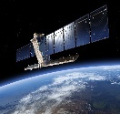
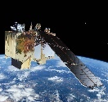





THE SENTINELS
FULL, FREE AND OPEN
Sentinel Mission and Status
Key Features
SENTINEL-1:
4-40m resolution, 6 days revisit at equator
2 Sats in orbit
Polar-orbiting, all-weather, day-and-night radar imaging
SENTINEL-2:
10-60m resolution, 5 days revisit time
2 Sats in Orbit
Polar-orbiting, multispectral optical, high-res imaging
SENTINEL-3:
300-1200m resolution, <2 days revisit
2 Sats in Orbit
Optical and altimeter mission monitoring sea and land parameters
SENTINEL-4:
8km resolution, 60 min revisit time
1 Sat in Orbit
Payload for atmosphere chemistry monitoring on MTG-S
SENTINEL-5p:
7-68km resolution, 1 day revisit
1 Sat in Orbit
Mission to reduce data gaps between Envisat, and S-5
SENTINEL-5:
7.5-50km resolution, 1 day revisit
Launched in 2021
Payload for atmosphere chemistry monitoring on MetOp 2ndGen
SENTINEL-6:
10 day revisit time
Launched in 2020
Radar altimeter to measure sea-surface height globally

Slide 4
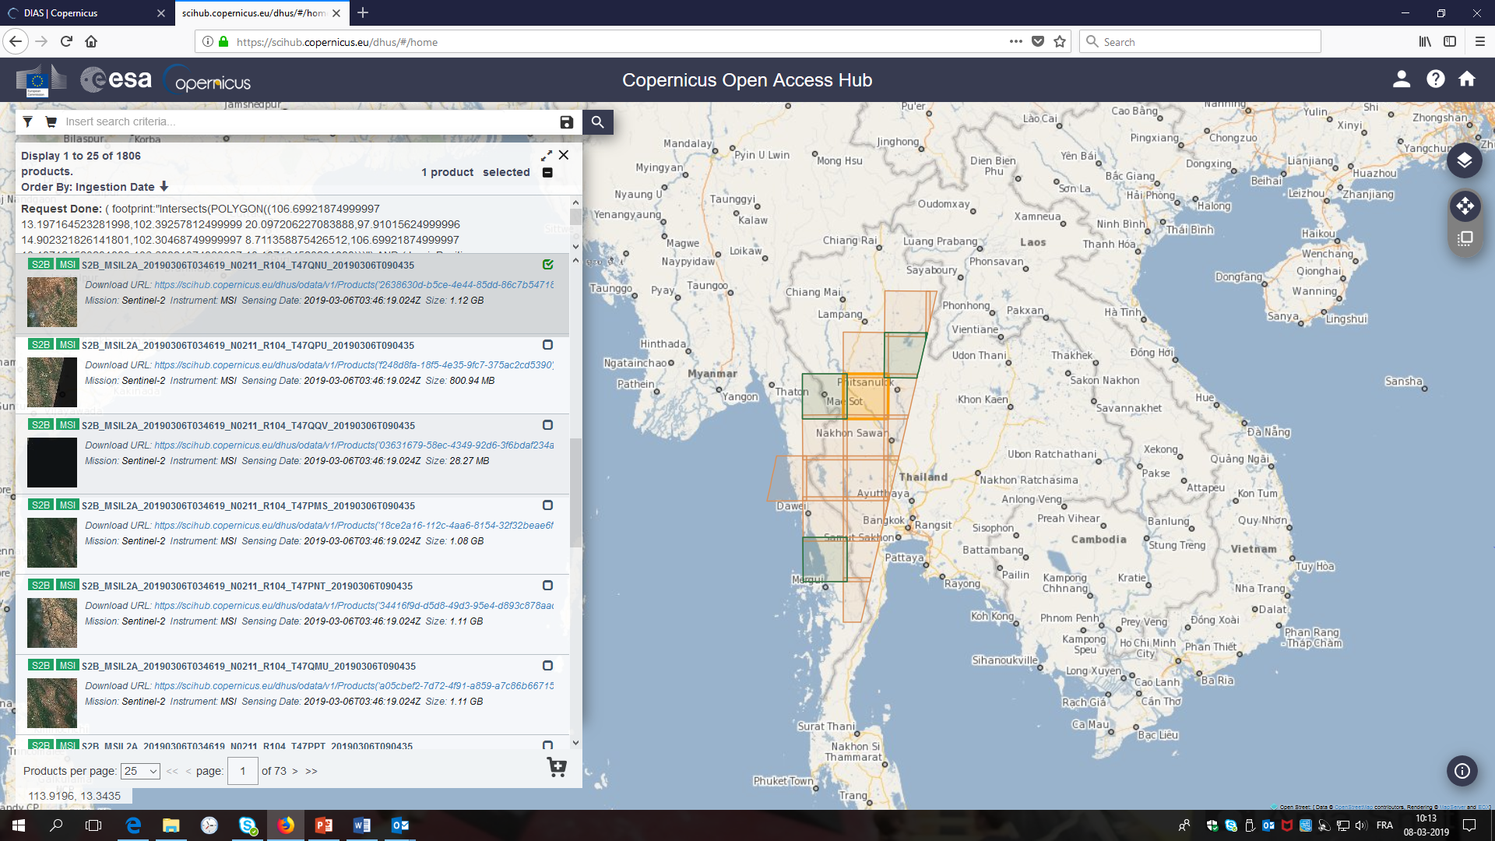
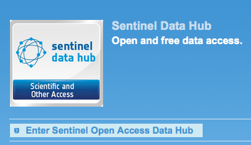
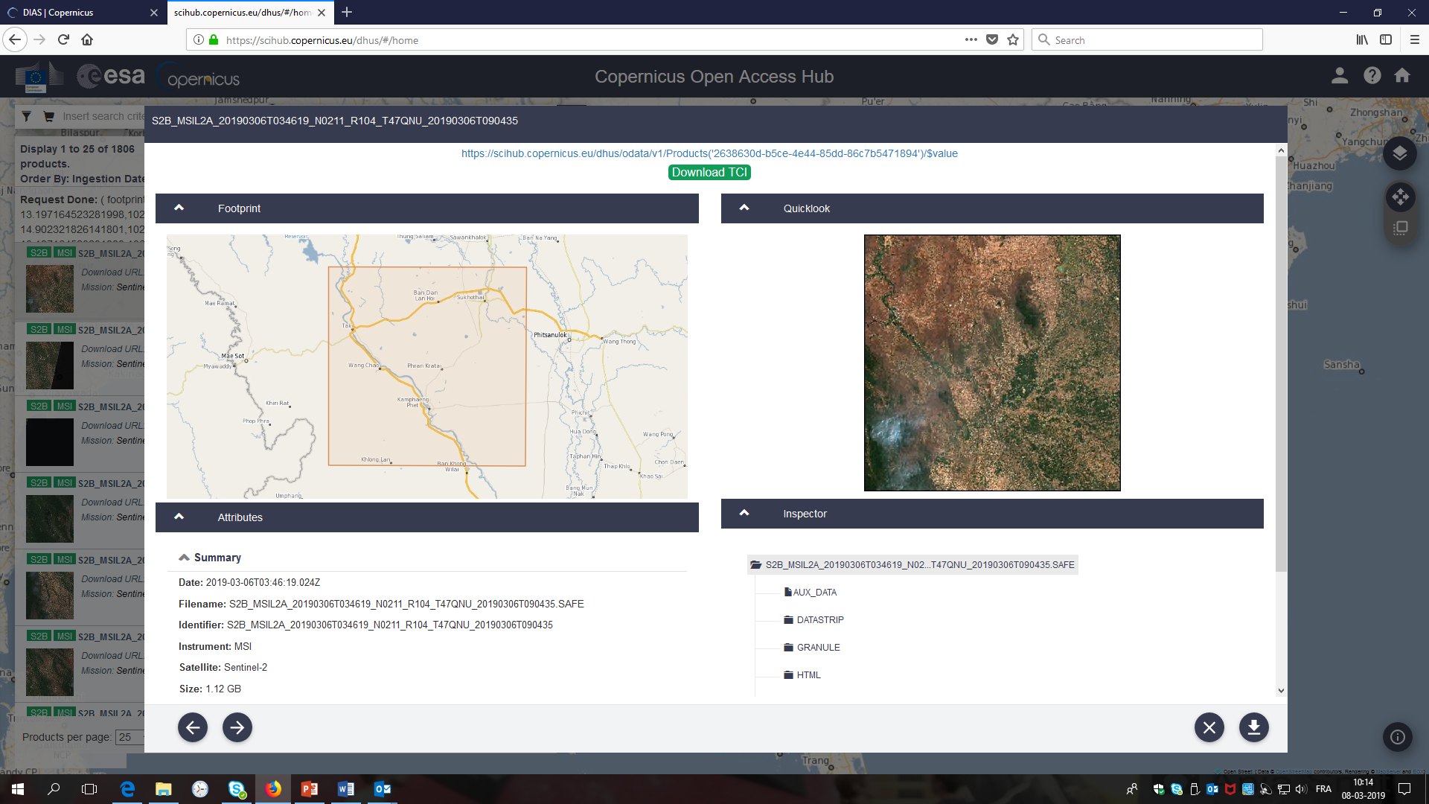
Sentinel data Science HUB
Online data access at: sentinels.copernicus.eu
ESA Data Hub Software (DHuS) provides an open source Web Interface
Easy Access, light registration
https://scihub.copernicus.eu/

Slide 5
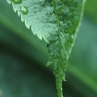


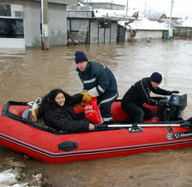
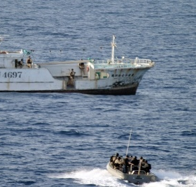
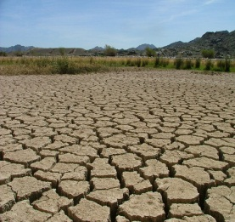
COPERNICUS Core Services
Services monitoring Earth systems
global component;
Pan-European component;
Local component
provides regular and systematic reference information on the physical state, variability and dynamics of the ocean and marine ecosystems (temperature, salinity, sea level, currents, wind and sea ice)
provides continuous data and information on atmospheric composition (greenhouse gases (carbon dioxide and methane), reactive gases (e.g. carbon monoxide, oxidised nitrogen compounds, sulphur dioxide), ozone, aerosols
Global
Land
Marine
Atmosphere
provides all actors involved in the management of natural disasters, man-made emergency situations, and humanitarian crises with timely and accurate geo-spatial information derived from satellite remote sensing and completed by available in situ or open data sources
Border surveillance (real time data on what is happening on land and sea around EU borders;
Maritime surveillance (safety of navigation, support to fisheries control, combatting marine pollution, and law enforcement;
Support to EU External Action (providing decision makers with geo-information on remote, difficult to access areas)
provides access to several climate indicators (temperature increase, sea level rise, ice sheet melting, warming up of the ocean) and climate indices (based on records of temperature, precipitation, drought event)
Emergency
Security
Climate Change

Slide 6
Operational Core Services – Added Value
Long term and reliable provision of products and services for user applications
Delivery of fully validated and quality controlled products and services
Free and open access – COPERNICUS as public good
Support to EU policies at international level & EU commitments under treaties & conventions – fuel Europe’s contribution to GEOSS
Wide range of applications: water management, desertification, natural resources management, food security, biodiversity, forestry, agriculture, Land cover & use change, …
Notes:
The total amount of 14.8 billion euros will be allocated for the programme with 9.1 billion euros for Galileo and EGNOS, 5.42 billion euros for Copernicus and 442 million euros for SSA and Govsatcom

Slide 7
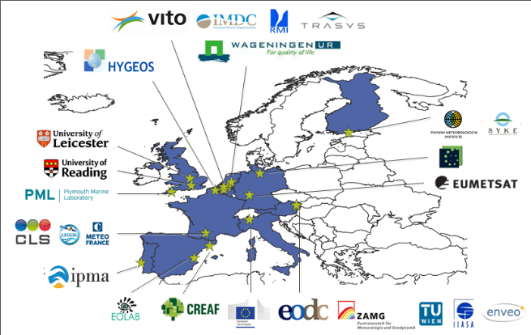
Building on European expertise
50+ industry partners
250+ experts

Slide 8
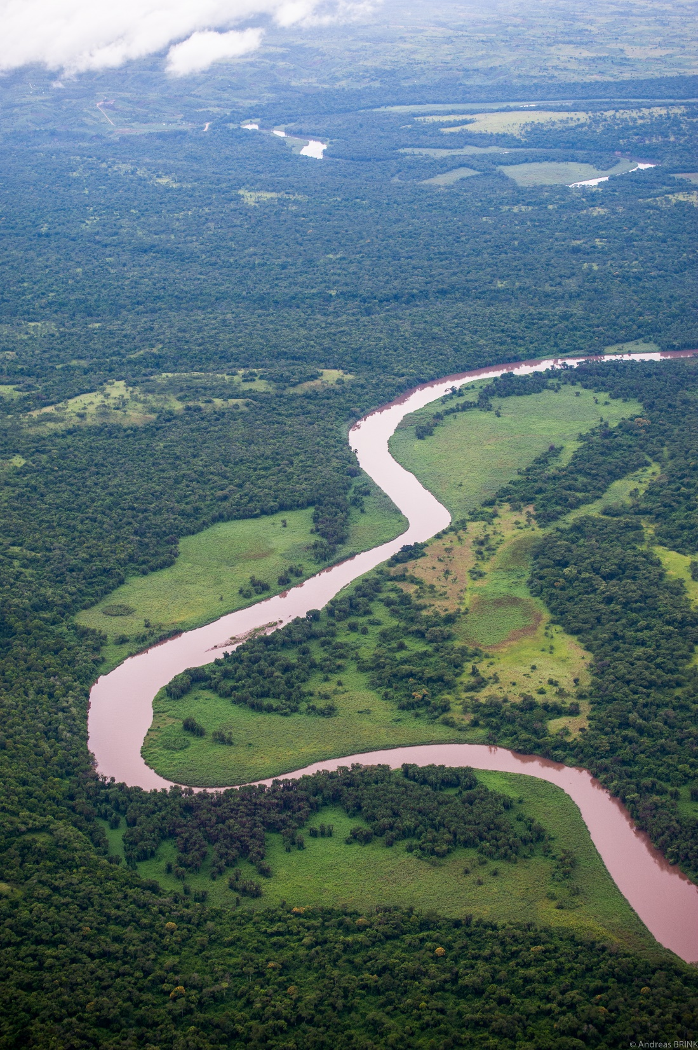
Global Land Component:
High Resolution
Hot Spot Monitoring

Slide 9
Global Land Cover
The Global Land Cover Layers:
more than a ‘map’, it is a systematic service providing dynamic, yearly, user-oriented global land cover maps from 2015
Notes:
The first version of the Copernicus Global Land Cover Layers at 100m at global scale for the year 2015 (2016-2018 to follow later this year).
The product is derived from the PROBA-V 100m Collection 1 dataset and a training dataset collected through the Geo-WIKI at 10m resolution.
The product consists of:
a discrete classification of 18 classes, including probabilities and a binary quality mask
four continuous vegetation cover fractions (0-100%) for bare, forest, grassland and shrub, …. See table on the left on the slide
one layer describing the water bodies occurence (0-100%) during the year
The overall accuracy is 80%

Slide 10
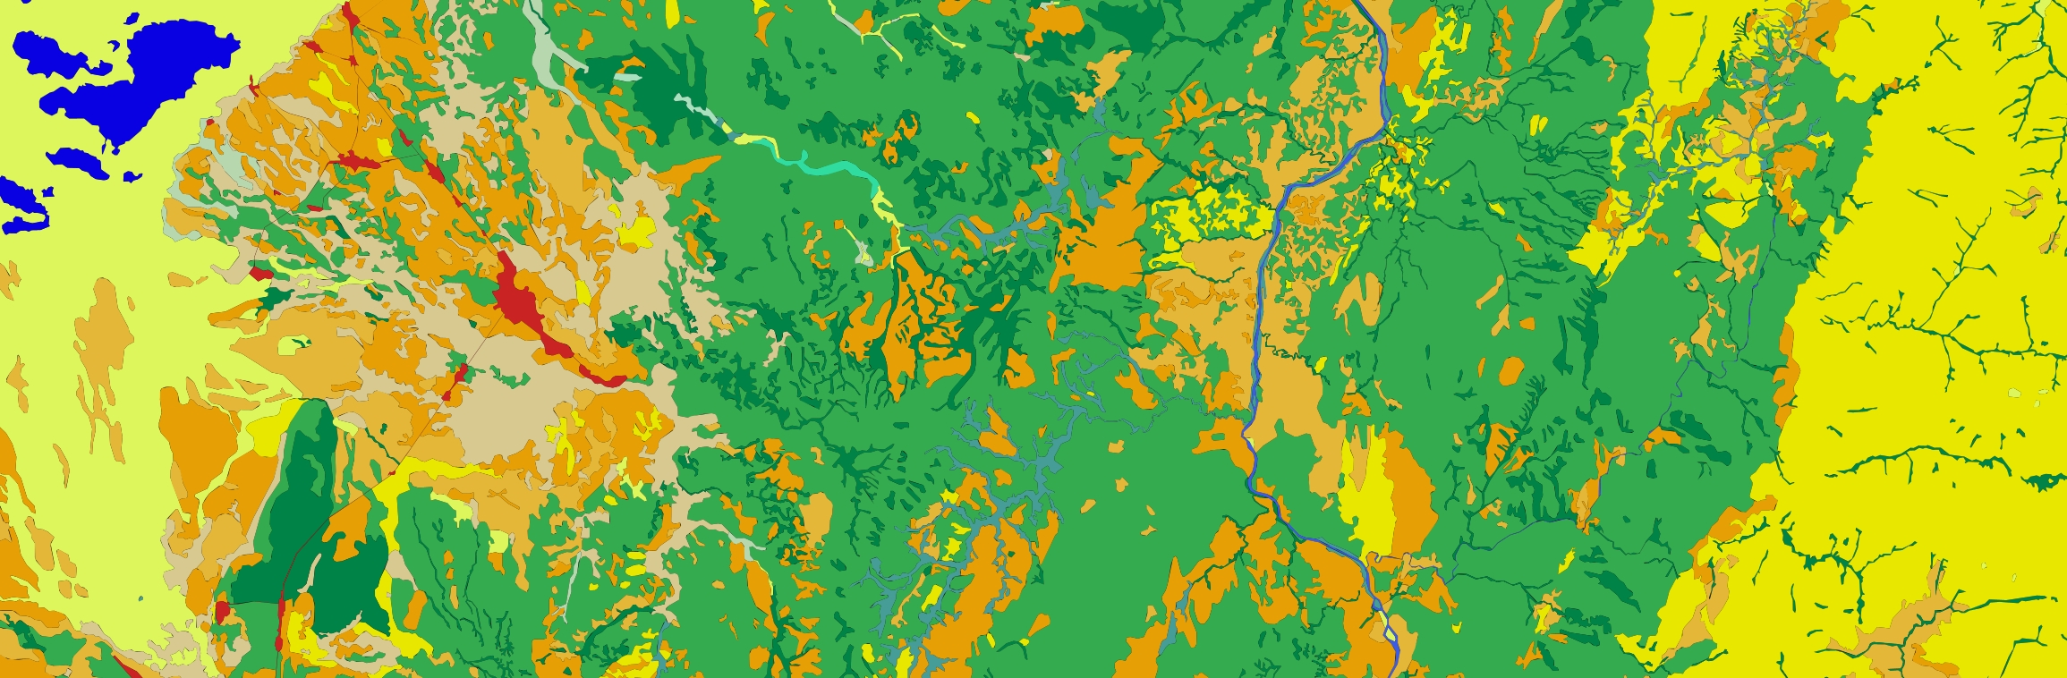
Hot Spot: Aim and Status
To produce land cover and land cover change maps and related indicators over specific Areas of Interest (AOI) using medium to high resolution satellite data (from 1 to 30m pixel size)
To provide detailed land information on specific areas of interest globally
To answer to ad-hoc requests within the domain of the sustainable management of natural resources
To complement the near real time global monitoring service at low resolution
19 AOI mapped
About 1.3Mio km2 (in comparison Tanzania is about 947,300km2)

Slide 11
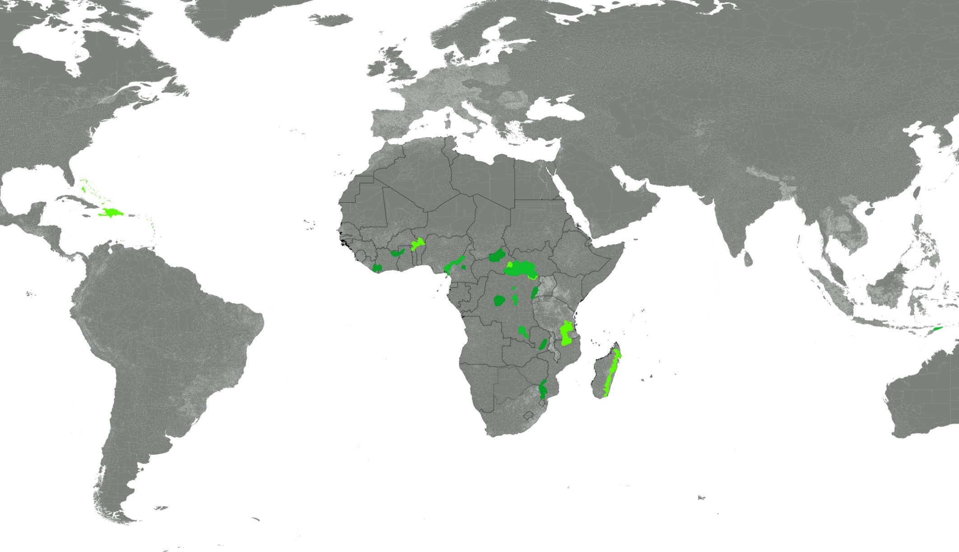
Areas mapped
CAF_01-Cross River-Takamanda-Mt Cameroon-Korup-
Area 79,533.9km2
CAF_06 Manovo-Gounda-St Floris -Bamingui-Bangoran
Area ca. 85,000km2
CAR_01 Carribbean (ACP)
Area 96,823 km2
WAF_04_Wapok
Area 57,777 km2
CAF_05_Garamba_addition
Area a 17,819 km2
Area b 11,540 km2
WAF_05 Comoe - Mole
Area ca. 40,000km2
CAF_05-Garamba-Lantoto-Bili Uere-Chinko-Southern-
Area 265,980.0km2
WAF_10 Tai-Sapo
Area ca. 40,000km2
CAF_02 Greater Virunga
Area ca. 40,000km2
PAC_01-Timor-Leste
Areas ca. 14,913km2
CAF_16 Mbam Djerem
Area 10,000km2
EAF_04_Niassa_Selous
Area 139,166 km2
CAF_07-Salonga
Area ca. 65,000km2
SAF_15 South Luangwa NP +
SAF_14 North Luangwa N
Areas ca. 35,000km2
CAF_99-Yangambi-
Area 7,276.22km2
SAF_21_Madagascar
Area 124,015 km2
CAF_15-Lomami-
Area 30,924.6km2
SAF_02 Great Limpopo
Area ca. 65,000km2
CAF_11-Kundelungu-Upemba-
Area 47,318.1km2
Total area: 1,273,246km2
Notes:
Overall, WH sites cover 11 % of all KLCs mapped, while non-WH PAs comprise 18 % The remaining non-protected areas surrounding the WH sites and PAs within the KLCs represent 71 % of the mapped area
This specific case shows the KLC of Tai-Sapo located in the border region of Côte d’Ivoire and Liberia. The dominant LC on the Liberian side, both inside the Sapo National Park, but also outside the PA, is forest cover (even if partly fragmented), while in neighbouring Côte d’Ivoire the entire area surrounding the WH site of Tai and the N’Zo Faunal Reserve is characterised by shrub crops, mainly cocoa plantations, as assessed by field visits. However, from a LC perspective the Tai WH site seems well protected, distinguished by nearly 100 % closed and open forest. Also, over 90 % of the bordering N’Zo Reserve North of the Tai National Park is covered by forest, though here we note a certain encroachment of human activities such as agriculture and some built-up areas.

Slide 12
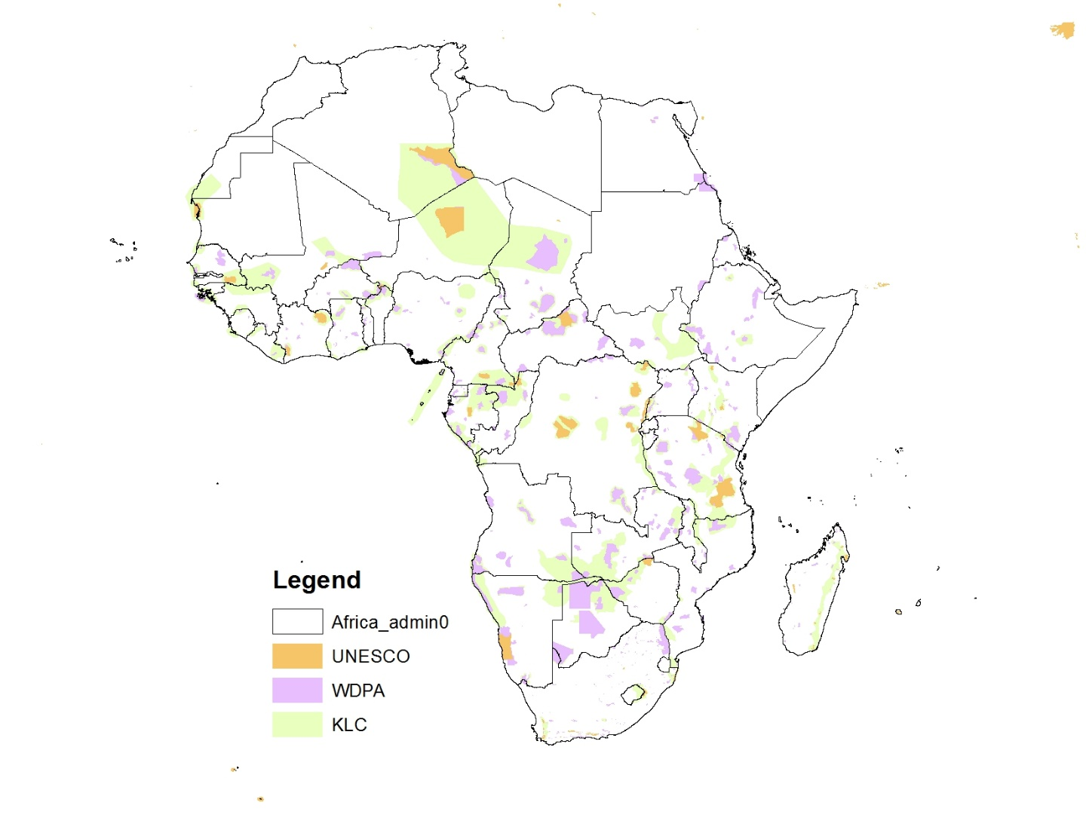
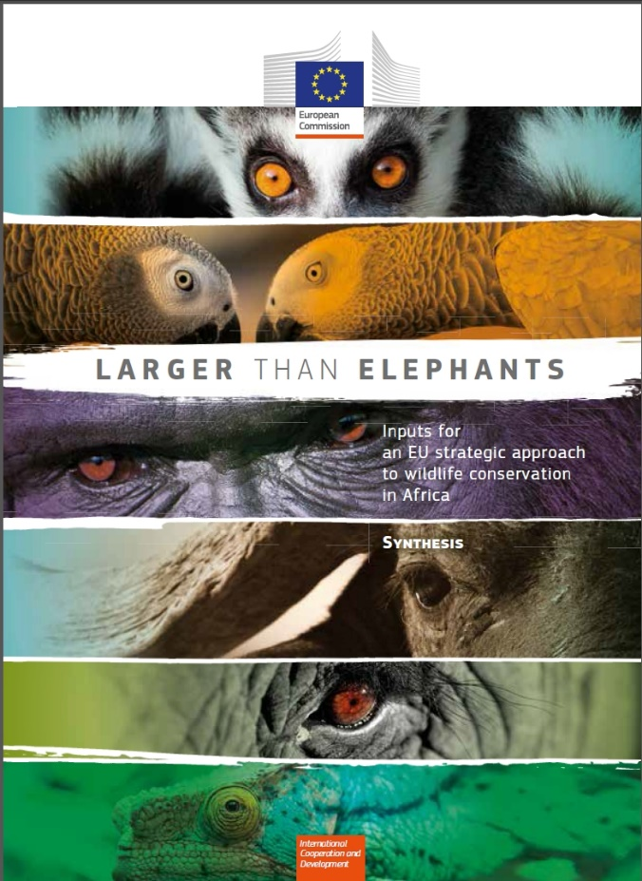
Key Landscapes for Conservation
Conservation of the core area
Economic development of the periphery
In order to alleviate poverty and reduce pressure on the park
Land-cover change is fundamental for identifying the main pressures
Pironio, E. & Mayaux, P. ed. (2015). Larger Than Elephants -
Inputs for an EU strategic approach to wildlife conservation in Africa.

Slide 13
Land Cover Classification Profiles
Land Cover Classification and Mapping Profile level | Description LCCS Level | Variable Minimum Mapping Unit | LCCS Classifier requirements and/or restrictions | period requested
A | Generic - LCCS Dichotomous | (b) 0.5 - 5 ha | up to 3rd level of LCCS Dichotomous phase [8 classes] | (a ) present [data representative for the last 2 years]
 |  | (c) >5 - 25 ha |  | (b ) 2010 (+ - 5)
 |  |  |  | (c ) 2000 (+ - 5)
 |  |  |  | (d ) 1990 (+ - 5)
B | Detailed - LCCS Modular-hierarchical | (a ) < 0.5 ha | (a ) up to level 1 of the LCCS modular phase(further to level 3 of the LCCS dichotomous phase) | (a ) present [data representative for the last 2 years] (b ) 2010 (+ - 5) (c) 2000 (+ - 5) (d) 1990 (+ - 5)
 |  | (b ) 0.5 - 5 ha | (b ) up to all levels of the LCCS modular phase - covering all pure land cover classifiers [requrements/ restrictions for certain cases are specified in table 2]
 |  | (c ) >5 - 25 ha
Szantoi, Z., Brink, A., Lupi, A., Mammone, C., and Jaffrain, G.: Key landscapes for conservation land cover and change monitoring, thematic and validation datasets for sub-Saharan Africa, Earth Syst. Sci. Data, 12, 3001–3019, https://doi.org/10.5194/essd-12-3001-2020, 2020.

Slide 14
LCCS Legend-Level A
LC | DGROUP, LCCLabel | Legend level | Class_Name
Dichotomous Phase | A11 - Cultivated and Managed Terrestrial Area(s) | A | Agriculture
Dichotomous Phase | A12 - Natural And Semi-Natural Primarily Terrestrial Vegetation | A | Natural vegetation
Dichotomous Phase | A23 - Cultivated Aquatic or Regularly Flooded Area(s) | A | Acquatic agriculture
Dichotomous Phase | A24 - Natural And Semi-Natural Aquatic or Regularly Flooded Vegetation | A | Wetlands
Dichotomous Phase | B15 - Artificial Surfaces and Associated Area(s) | A | Urban
Dichotomous Phase | B16 - Bare Area(s) | A | Bare
Dichotomous Phase | B27 - Artificial Waterbodies, Snow and Ice | A | Artificial Waterbodies
Dichotomous Phase | B28 - Natural Waterbodies, Snow and Ice | A | Natural Waterbodies

Slide 15
LCCS Legend-Level B
GROUP | DGROUP | LC | LCCCode | LCCLevel | LCCLabel | MapCode | Legend level | Class name
1 | A11 - Cultivated and Managed Terrestrial Area(s) | Dichotomous Phase | 0003 | A11 | Cultivated and Managed Terrestrial Area(s) | 3 | A | Agriculture
2 | A12 - Natural And Semi-Natural Primarily Terrestrial Vegetation | Dichotomous Phase | 0004 | A12 | Natural And Semi-Natural Primarily Terrestrial Vegetation | 4 | A | Natural vegetation
3 | A23 - Cultivated Aquatic or Regularly Flooded Area(s) | Dichotomous Phase | 0006 | A23 | Cultivated Aquatic or Regularly Flooded Area(s) | 6 | A | Acquatic agriculture
4 | A24 - Natural And Semi-Natural Aquatic or Regularly Flooded Vegetation | Dichotomous Phase | 0007 | A24 | Natural And Semi-Natural Aquatic or Regularly Flooded Vegetation | 7 | A | Wetlands
5 | B15 - Artificial Surfaces and Associated Area(s) | Dichotomous Phase | 0010 | B15 | Artificial Surfaces and Associated Area(s) | 10 | A | Urban
6 | B16 - Bare Area(s) | Dichotomous Phase | 0011 | B16 | Bare Area(s) | 11 | A | Bare
7 | B27 - Artificial Waterbodies, Snow and Ice | Dichotomous Phase | 0013 | B27 | Artificial Waterbodies, Snow and Ice | 13 | A | Artificial Waterbodies
8 | B28 - Natural Waterbodies, Snow and Ice | Dichotomous Phase | 0014 | B28 | Natural Waterbodies, Snow and Ice | 14 | A | Natural Waterbodies
11 | A11 - Cultivated and managed terrestrial areas | Tree Crops | 10004-W7 | A1B1B5-W7 | Continuous Large To Medium Sized Field(s) (>2 ha) Of Tree Crop(s) Crop Cover: Plantation(s) | 31 | B (a) | Tree Plantations Large
11 | A11 - Cultivated and managed terrestrial areas | Tree Crops | 10010-W7 | A1B2B5-W7 | Continuous Small Sized Field(s) (<2 ha) Of Tree Crop(s) Crop Cover: Plantation(s) | 32 | B (a) | Tree Plantations Small
11 | A11 - Cultivated and managed terrestrial areas | Tree Crops | 10004-W8 | A1B1B5-W8 | Continuous Large To Medium Sized Field(s) (>2 ha) Of Tree Crop(s) Crop Cover: Orchard(s) | 33 | B (a) | Tree Orchard Large
11 | A11 - Cultivated and managed terrestrial areas | Tree Crops | 10010-W8 | A1B2B5-W8 | Continuous Small Sized Field(s) (<2 ha) Of Tree Crop(s) Crop Cover: Orchard(s) | 34 | B (a) | Tree Orchard Small
11 | A11 - Cultivated and managed terrestrial areas | Shrub Crops | 10016 | A2B1B5 | Continuous Large To Medium Sized Field(s) (>2 ha) Of Shrub Crop(s) | 55 | B (a) | Shrub Crops
11 | A11 - Cultivated and managed terrestrial areas | Shrub Crops | 10022 | A2B2B5 | Continuous Small Sized Field(s) (<2 ha) Of Shrub Crop(s) | 56 | B (a) | Shrub Crops Small
11 | A11 - Cultivated and managed terrestrial areas | Herbaceous Crops | 10028 | A3B1B5 | Continuous Large To Medium Sized Field(s) (>2 ha) Of Herbaceous Crop(s) | 59 | B (a) | Herbaceous Crops
11 | A11 - Cultivated and managed terrestrial areas | Herbaceous Crops | 10034 | A3B2B5 | Continuous Small Sized Field(s) (<2 ha) Of Herbaceous Crop(s) | 60 | B (a) | Herbaceous Crops Small
12 | A12 – Natural or semi-natural terrestrial vegetation | Trees | 20007 | A3A10B2C1 | Continuous Closed (>70-60) Trees | 77 | B (a) | Forest Closed
12 | A12 – Natural or semi-natural terrestrial vegetation | Trees | 20015 | A3A11B2C1 | Continuous Open General (70-60)-(20-10)% Trees | 78 | B (a) | Forest Open
12 | A12 – Natural or semi-natural terrestrial vegetation | Shrubs | 21451-121340 | A4A20B3C1-A21 | Continuous Closed to Open (100-40)% Shrubs | 112 | B (a) | Shrubs Closed
12 | A12 – Natural or semi-natural terrestrial vegetation | Shrubs | 20023-3012 | A4A11B3C1-A13 | Continuous Open (40 - (20-10)%) Shrubs | 116 | B (a) | Shrubs Open
12 | A12 – Natural or semi-natural terrestrial vegetation | Grasslands | 21455-121340 | A2A20B4C1-A21 | Continuous Closed to Open (100-40)% Herbaceous Vegetation | 148 | B (a) | Grasslands Closed
12 | A12 – Natural or semi-natural terrestrial vegetation | Grasslands | 20039-3012 | A2A11B4C1-A13 | Continuous Open (40 - (20-10)%) Herbaceous Vegetation | 152 | B (a) | Grasslands Open
15 | B15 - Artificial surfaces and associates area(s) | Built Up Areas | 5001 | A1 | Built Up Area(s) | 184 | B (a) | Urban - Built Up
15 | B15 - Artificial surfaces and associates area(s) | Non Built Up Areas | 5004 | A2 | Non Built Up Area(s) | 185 | B (a) | Urban - Not Built Up
23 | A23 – Cultivated aquatic or regularly flooded areas | Woody Crops | 3405 | A3B1B5 | Continuous Large To Medium Sized Field(s) (>2 ha) Of Woody Crops - Aquatic Or Regularly Flooded | 155 | B (a) | Agriculture flooded - Woody
23 | A23 – Cultivated aquatic or regularly flooded areas | Woody Crops | 3472 | A3B2B5 | Continuous Small Sized Field(s) (<2 ha) Of Woody Crops - Aquatic Or Regularly Flooded | 156 | B (a) | Agriculture flooded - Woody Small
23 | A23 – Cultivated aquatic or regularly flooded areas | Herbaceous Crops | 3004 | A1B1B5 | Continuous Large To Medium Sized Field(s) (>2 ha) Of Graminoid Crops - Aquatic Or Regularly Flooded | 159 | B (a) | Agriculture flooded - Graminoid
23 | A23 – Cultivated aquatic or regularly flooded areas | Herbaceous Crops | 3010 | A1B2B5 | Continuous Small Sized Field(s) (<2 ha) Of Graminoid Crops - Aquatic Or Regularly Flooded | 160 | B (a) | Agriculture flooded - Graminoid Small
24 | A24 – Natural or semi-natural aquatic vegetation | Trees | 40004 | A3A12B2 | Closed (>70-60)% Trees - Aquatic vegetation | 165 | B (a) | Forest Closed Acquatic
24 | A24 – Natural or semi-natural aquatic vegetation | Trees | 40008 | A3A13B2 | Open General (70-60)-(20-10)% Trees - Aquatic vegetation | 166 | B (a) | Forest Open Acquatic
24 | A24 – Natural or semi-natural aquatic vegetation | Shrubs | 41896-60686 | A4A20B3-A21 | Closed to Open (100-40)% Shrubs - Aquatic vegetation | 171 | B (a) | Shrubs Closed Acquatic
24 | A24 – Natural or semi-natural aquatic vegetation | Shrubs | 40012-287 | A4A13B3-A15 | Very Open (40 - (20-10)%) Shrubs - Aquatic vegetation | 175 | B (a) | Shrubs Open Acquatic
24 | A24 – Natural or semi-natural aquatic vegetation | Grasslands | 42156-60686 | A2A20B4-A21 | Closed to Open (100-40)% Herbaceous Vegetation - Aquatic vegetation | 178 | B (a) | Grasslands Closed Acquatic
24 | A24 – Natural or semi-natural aquatic vegetation | Grasslands | 40020-287 | A2A13B4-A15 | Very Open (40 - (20-10)%) Herbaceous Vegetation - Aquatic vegetation | 182 | B (a) | Grasslands Open Acquatic
27 | B27 – Artificial water bodies, snow and ice | Artificial Waterbodies | 7001-1 | A1-A4 | Artificial Waterbodies (Flowing) | 186 | B (a) | Flowing Artificial Waterbodies
27 | B27 – Artificial water bodies, snow and ice | Artificial Waterbodies | 7001-5 | A1-A5 | Artificial Waterbodies (Standing) | 187 | B (a) | Standing Artificial Waterbodies
28 | B28 – Natural water bodies, snow and ice | Natural Waterbodies | 8001-1 | A1-A4 | Natural Waterbodies (Flowing) | 190 | B (a) | River
28 | B28 – Natural water bodies, snow and ice | Natural Waterbodies | 8001-5 | A1-A5 | Natural Waterbodies (Standing) | 191 | B (a) | Lake
28 | B28 – Natural water bodies, snow and ice | Natural Snow/Ice | 8005 | A2 | Snow | 192 | B (a) | Snow
28 | B28 – Natural water bodies, snow and ice | Natural Snow/Ice | 8008 | A3 | Ice | 193 | B (a) | Ice

Slide 16
Users
DG INTPA (before DEVCO)
  BIOPAMA - Biodiversity and Protected Areas Management Programme (Africa-Caribbean-Pacific)
EU Delegations
  Democratic Republic of Congo - baseline land cover/land cover change survey for a large 11th EDF funded Protected Areas (PA) – Key Landscape for Conservation (KLC) programme
  Timor Leste - baseline land cover/land cover change survey for a large 11th EDF agro-forestry programme
  Cote d’Ivoire – mapping the extent of cocoa
Ministries of Wildlife and Park authorities
Potential users
  Further EU Delegations, EU member states and national development agencies, international organisations, universities, local authorities, NGO’s, etc.
Nearly 10,000 web site visits since launch in early 2019

Slide 17
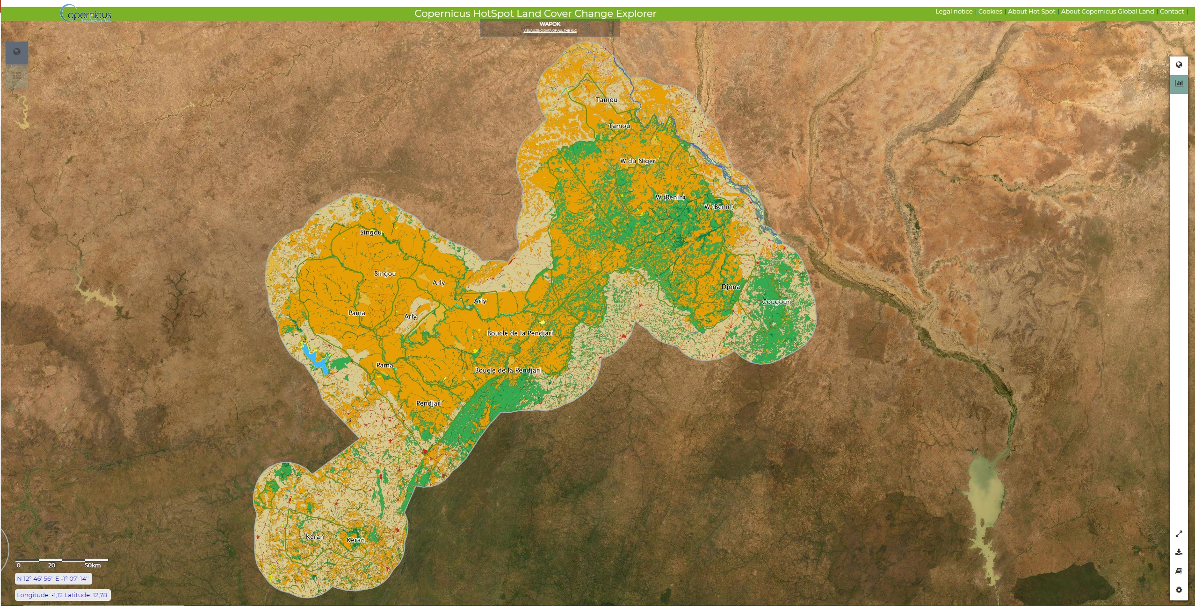
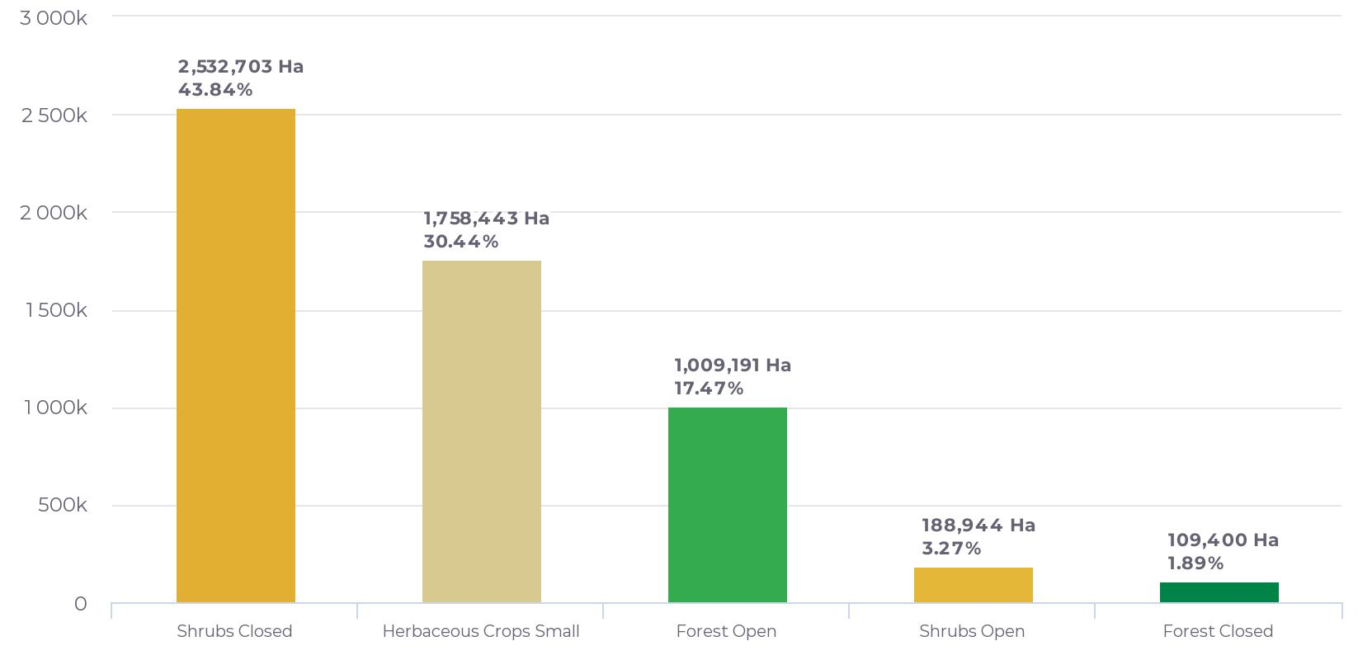
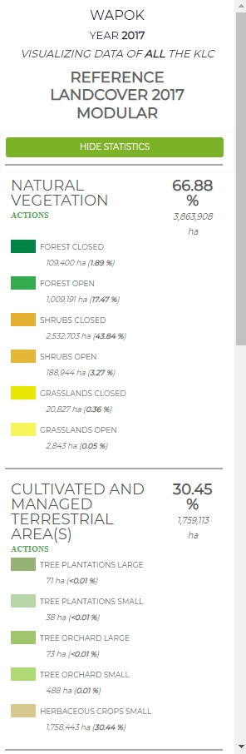
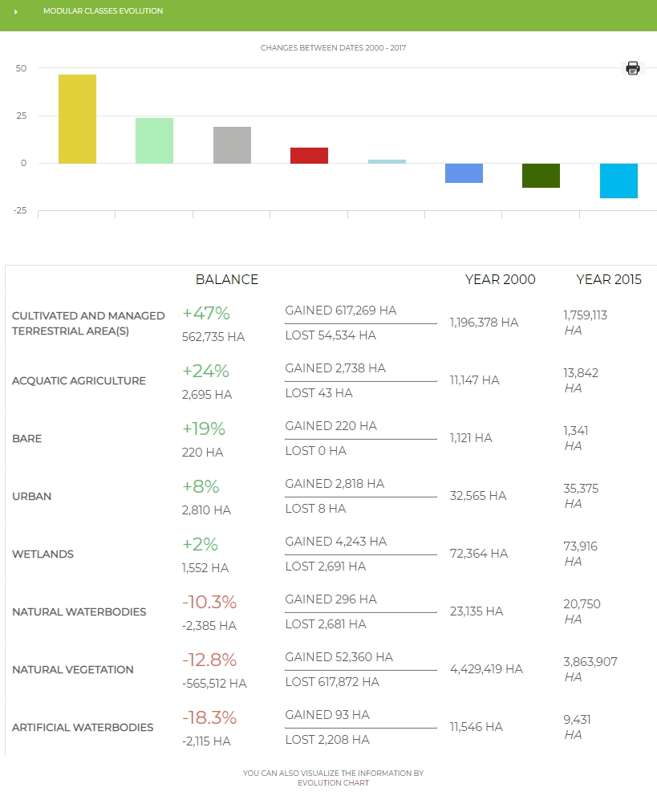
WAPOK – Land Cover
https://land.copernicus.eu/global/hsm

Slide 18
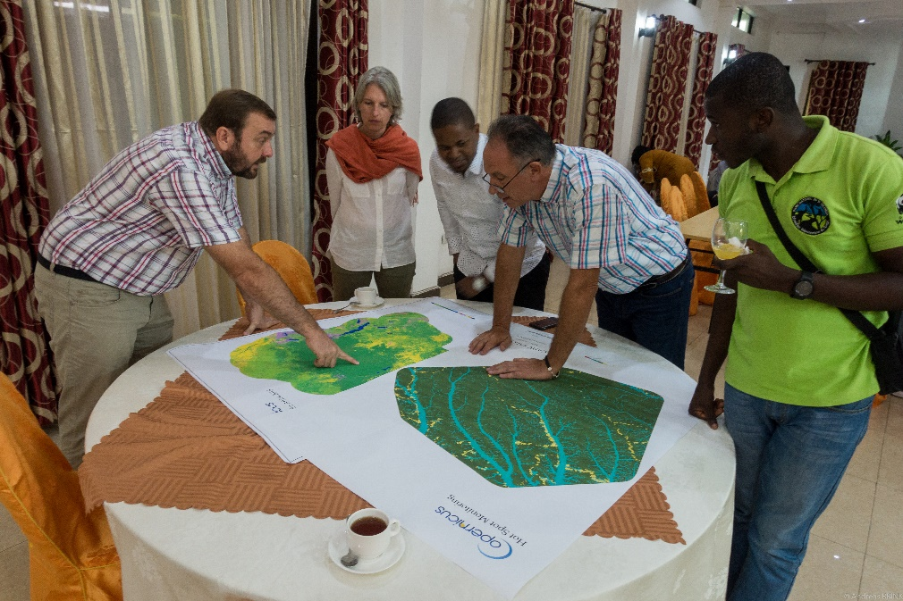
C-HSM Goma Workshop

Slide 19
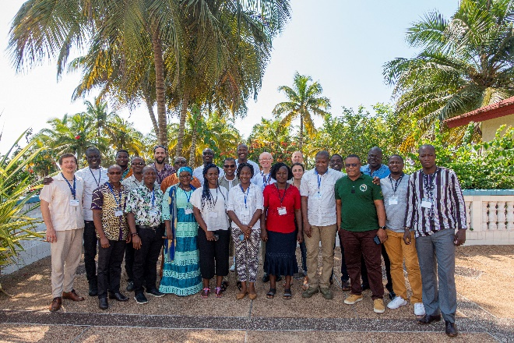
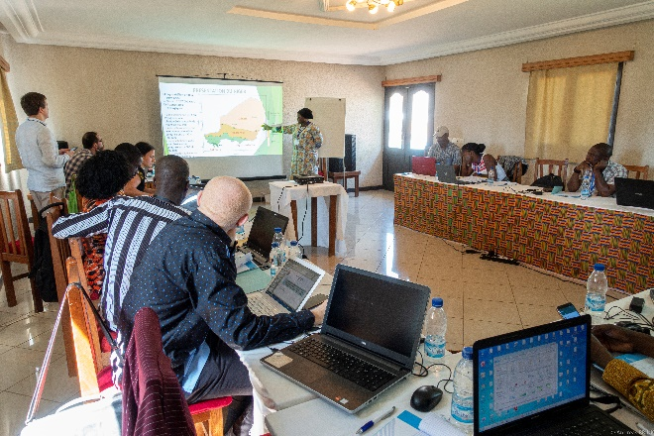
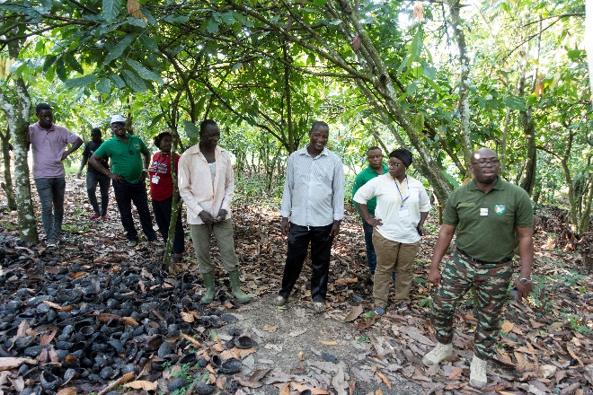
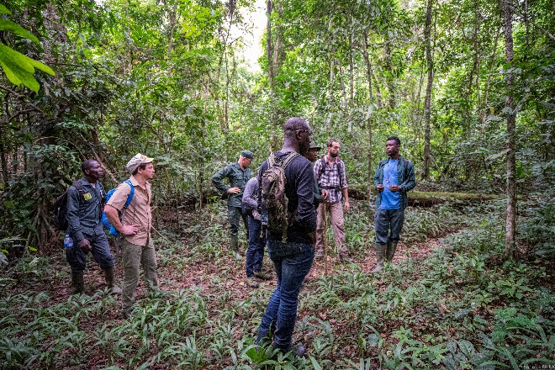
C-HSM West Africa Land Cover capacity building workshop
EU Delegation to Cote d’Ivoire: formal request will be send to C-HSM to map the extend of cocoa in Cote d’Ivoire and Ghana
Lt-Col. DIARRASSOUBA Issa (OIPR): “this training has provided West African protected area managers with indispensable tools in the face of current issues of natural resource management…”
KOIM Nora (GIZ): “I want to thank you again for the excellent training. It was obvious that you put a lot of work into it. The selection of participants was also very appropriate”
MAHAMA Ali (Mole Park Manager): “in the past we tried to candidate the Mole National Park (Ghana) as UNESCO Heritage site. But we failed due to lack of up to date data. Thanks to the Copernicus Hot Spot in providing us up to date land cover maps, I am confident we will now succeed in becoming a UNESCO Heritage site”

Slide 20
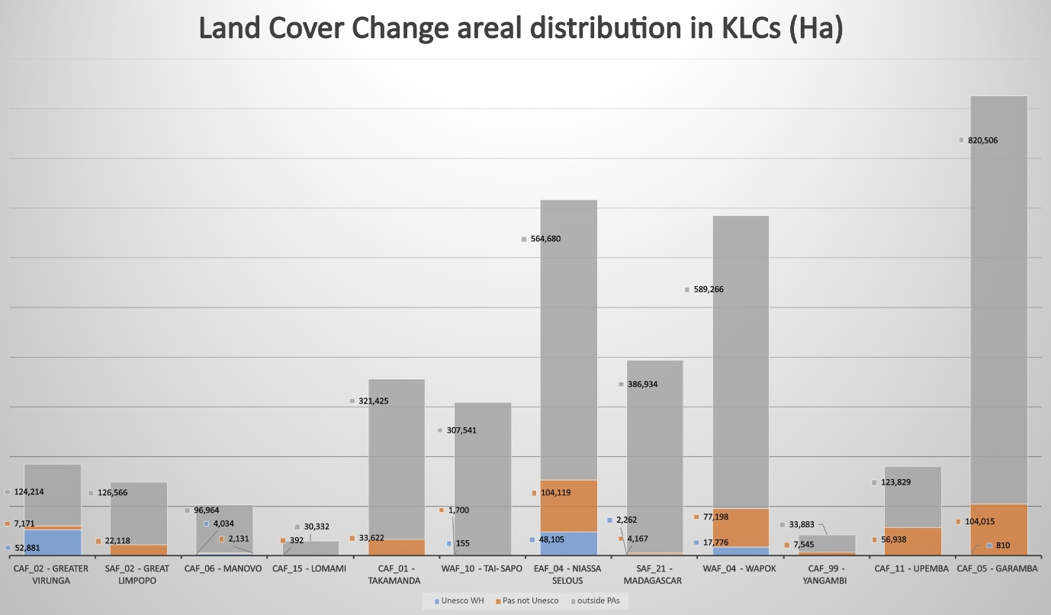
Comparing KLC’s
Notes:
The 15-year LCC assessment presented here reveals a diverse picture, as shown is figure 7. Large KLCs such as Garamba, Niassa-Selous and Wapok show proportionally greater changes compared to smaller KLCs, but all areas consistently show LCC in the buffer zones and, to a lesser extent, in PAs and WH sites. Usually, WH sites seem to be better protected from LCC than non-WH sites PAs, with the exception of Virunga where considerable deforestation took place, in particular in the southern sector of the park. For all areas, the general trend is towards natural vegetation being lost to agriculture. In the 15 years assessed, over 3 Mio ha of forests, wood and shrublands and grassland were converted, predominantly into agriculture. This is an area greater than the size of Rwanda. While 87 % of this conversion occurred outside the PAs, about 500,000 ha of natural vegetation was lost inside PAs, 30 % of which was from WH sites

Slide 21
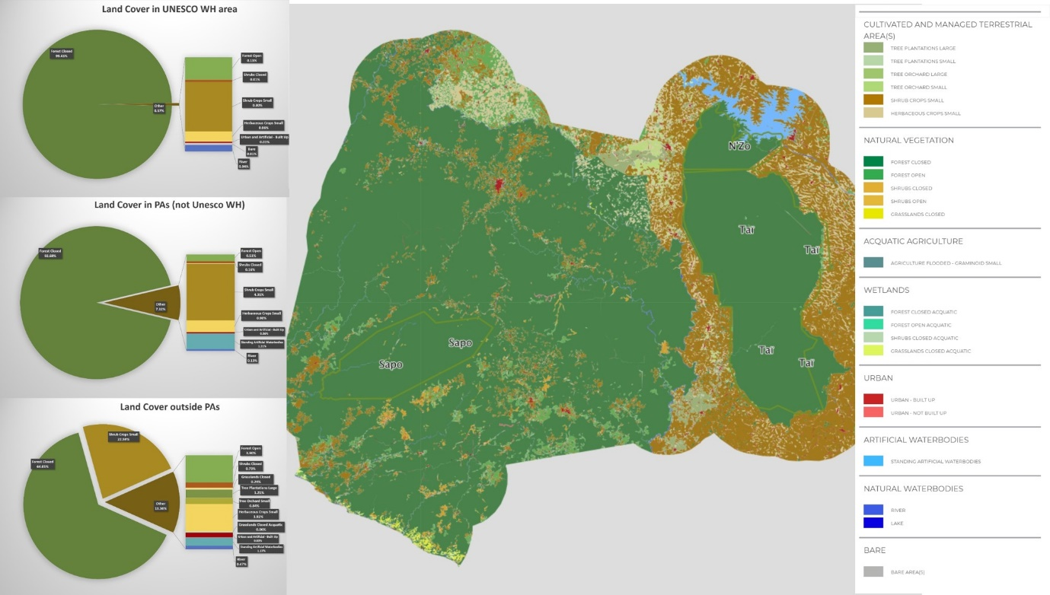
Tai-Sapo KLC Land Cover Dynamics
Notes:
LC map of the Tai-Sapo KLC in 2015 and pie charts of the corresponding statistics for LC in the Tai WH site (top), other non-WH PAs (N’Zo Faunal Reserve, Sapo National Park) (middle) and outside PAs (bottom)

Slide 22
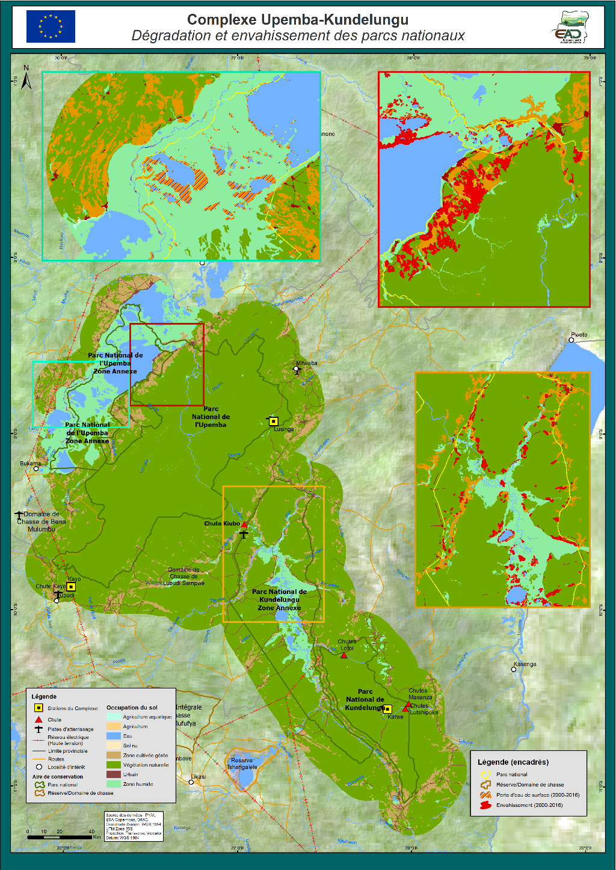
Upemba-Kundelungu complex
highlight the threats and pressures on the wetlands and the last population of elephants in the Katanga province and the wetlands which is one of the biggest RAMSAR site in the world (since 2017),
prioritize the actions of EU funds in the complex and the management plan of the complex and
bring some leverage in negotiations between EU/national agency in charge of the PAs and the private sector.

Slide 23
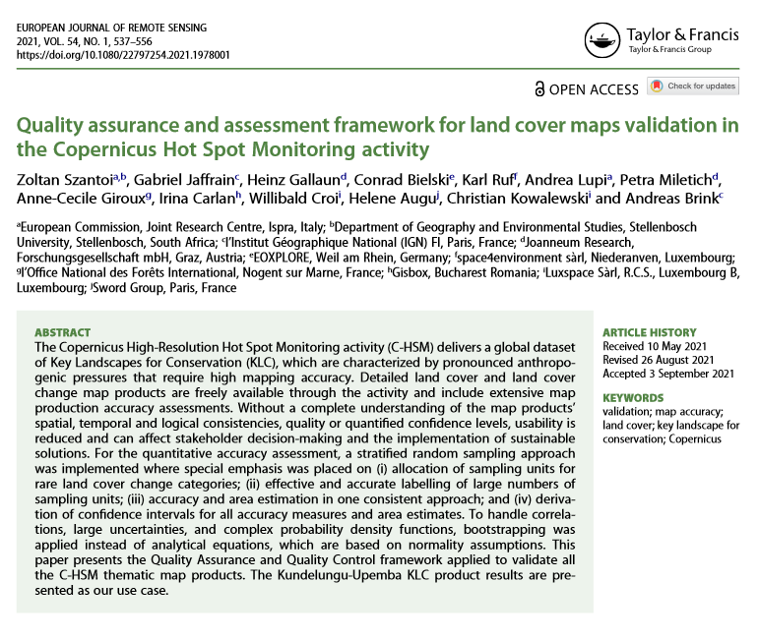
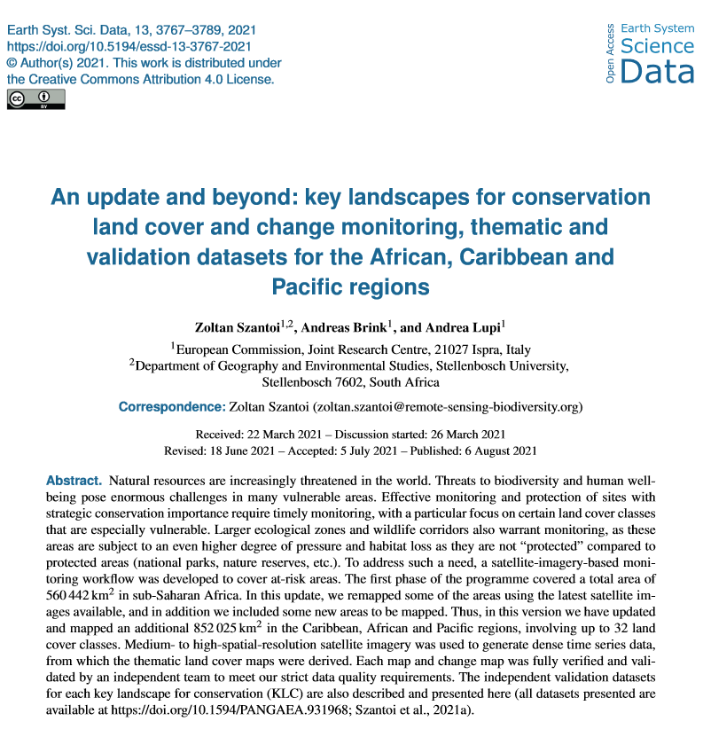
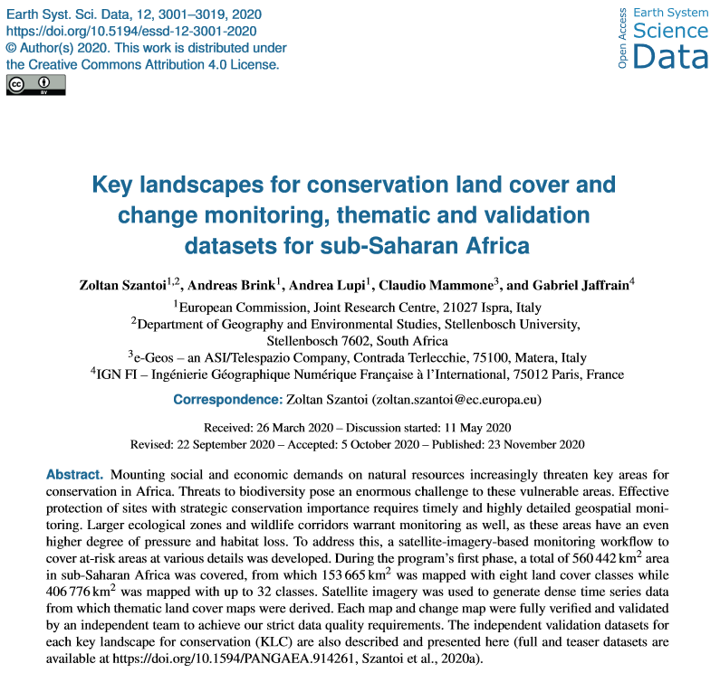
HotSpot Outcomes-2020/2021
  Scientific papers peer reviewed published:
    ‘’Quality assurance and assessment framework for land cover maps validation in the Copernicus Hot Spot Monitoring activity’’. European Journal of Remote Sensing ISSN, September 2021. ResearchGate link.
    ‘’ An update and beyond: key landscapes for conservation land cover and change monitoring, thematic and validation datasets for the African, Caribbean and Pacific regions’’. Earth System Science Data, August 2021. ResearchGate link.
    ‘’ Key landscapes for conservation land cover and change monitoring, thematic and validation datasets for sub-Saharan Africa’’. Earth System Science Data, November 2020. ResearchGate link.

Slide 24
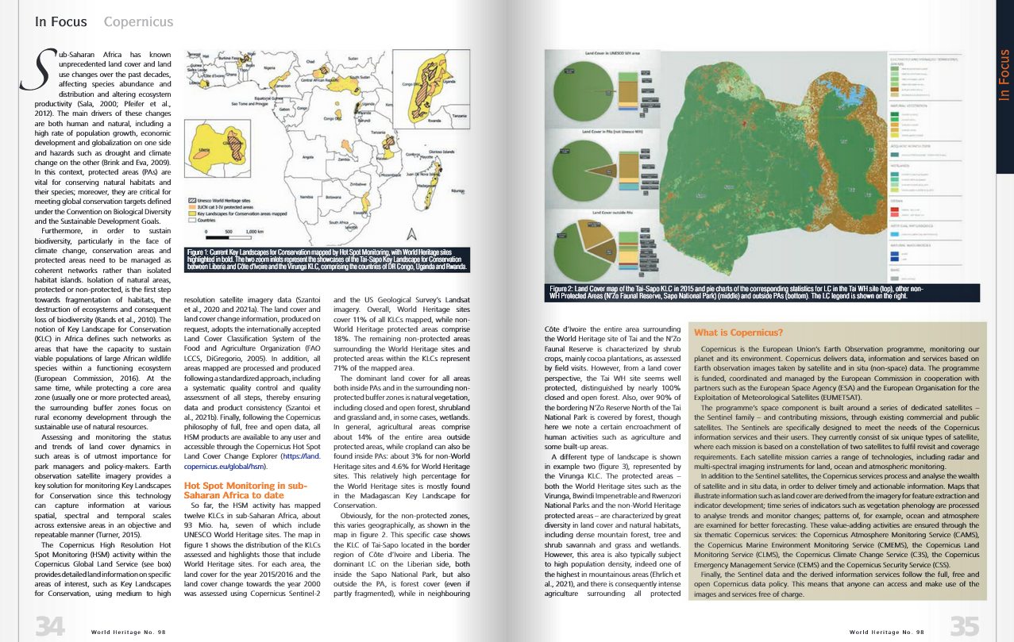
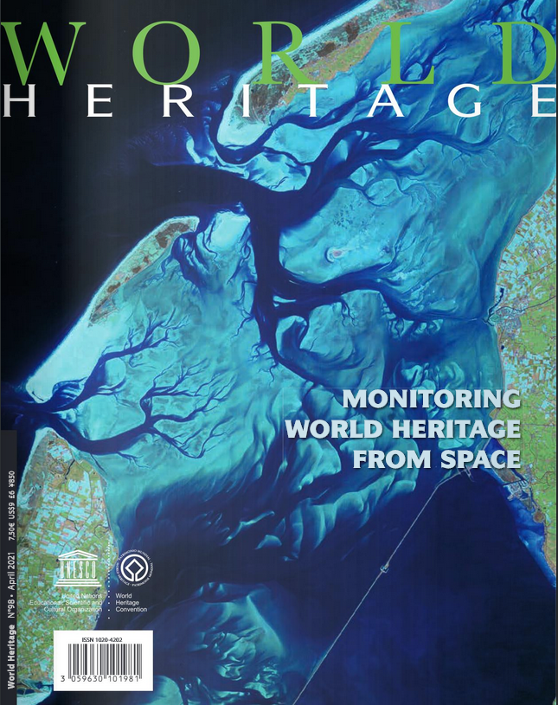
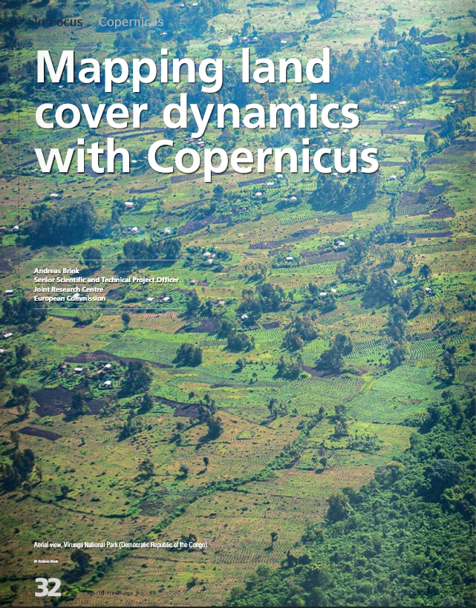
HotSpot Outcomes-2020/2021
  Journal contribution:
    World Heritage Journal, N.98. Article: ‘’Mapping land cover dynamics with Copernicus’’, April 2021. link.

Slide 25



STAY CONNECTED
@CopernicusLAND
land.copernicus.eu/global
land.copernicus.eu/global/viewing
andreas.brink@ec.europa.eu

